Slide 1



UNIVERSITY INSTITUTE OF ENGINEERING
COMPUTER SCIENCE ENGINEERING
Bachelor of Engineering
Design and Analysis of Algorithms(CST-302/ITT-302)
Prepared By: Amrita Chaudhary (E8745)
Topic: Optimal Binary Search Tree
DISCOVER . LEARN . EMPOWER

Slide 2
Learning Objectives & Outcomes
Objective:
To understand the concept of optimal binary search tree.
Outcome:
Student will understand
Importance of optimal binary search tree

Slide 3
Optimal Binary Search Tree
A set of integers are given in the sorted order and another array freq to frequency count. Our task is to create a binary search tree with those data to find the minimum cost for all searches.
An auxiliary array cost[n, n] is created to solve and store the solution of subproblems. Cost matrix will hold the data to solve the problem in a bottom-up manner.

Slide 4
Example
Input:
The key values as node and the frequency.
Keys = {10, 12, 20}
Frequency = {34, 8, 50}
Output:
The minimum cost is 142.

Slide 5
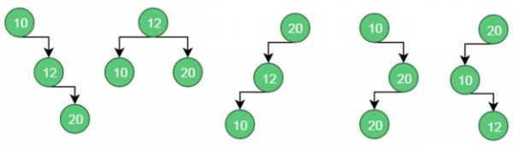
Possible BST from the given values
For case 1, the cost is: (34*1) + (8*2) + (50*3) = 200
For case 2, the cost is: (8*1) + (34*2) + (50*2) = 176.
Similarly for case 5, the cost is: (50*1) + (34 * 2) + (8 * 3) = 142 (Minimum)

Slide 6
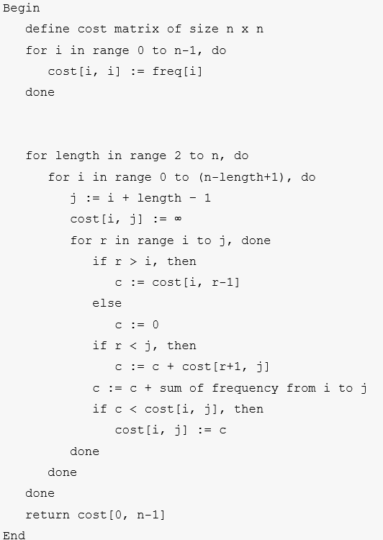
Algorithm

Slide 7
REFERENCES
Text books:
Cormen, Leiserson, Rivest, Stein, “Introduction to Algorithms”, Prentice Hall of India, 3rd edition 2012. problem, Graph coloring.
Websites:
https://www.tutorialspoint.com/Optimal-Binary-Search-Tree

Slide 8
Summary
  Dynamic programming:
  Optimal Binary search tree

Slide 9
THANK YOU

